Slide 1

INFORMATICS INSTITUTE OF TECHNOLOGY
Computer science practice
4COSC008C
Distributer denial of service/BotNet attacks: how can they be avoided? How can they help us learn lessons for better data protection? Does the Internet of Things pose new threats to our private data?
Module Leader’s Name-Ms. Sulochana Rupasinghe
Group Members
Name UoW Number IIT Number Sub Topic
1. M.H.V.Sithum w1742102 2018369
2. D.S. Sendanayaka w1742312 2018445
3. S.M.K.C. Wedage w1742101 2018368
4. K.V.H.C. Samaranayake w1742100 2018371
5. W.M.S. Perera w1742313 2018446
What is ddos. Impacts of ddos attcks. Examples for ddos attacks
What is botnet. Impacts of botnet aatcks. Examples for botnet attacks
What is IOT. Vulnerabilities of IOT. Threats of IOT
Data security and cyber attacks. Main issues identified. Prevention of ddos attacks
Life lessons that can be taken to avoid attacks and for better data protection

Slide 2
DOS & DDOS Attacks

Slide 3

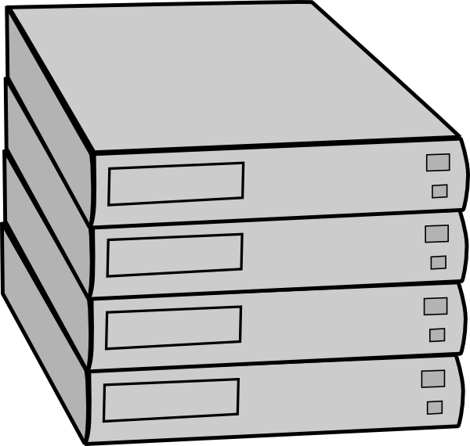
What is DOS & DDOS attacks?
DOS:- Single Device, Single internet connection, Single target
DDOS:-Multiple devices, Multiple Internet connections
Legitimate user
server

Slide 4
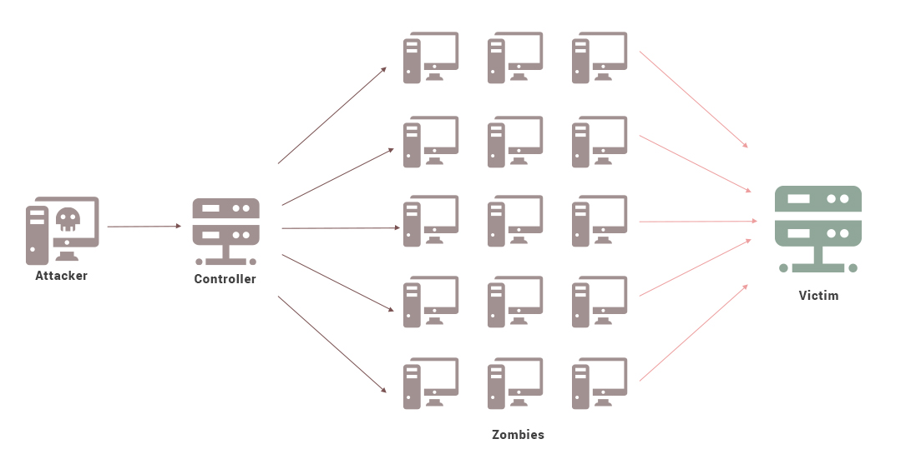
How this attacks work

Slide 5
Methods of attacks
UDP Flood
ICMP (Ping) Attack
SYN Flood
Ping of Death
HTTP Flood

Slide 6
Botnet

Slide 7
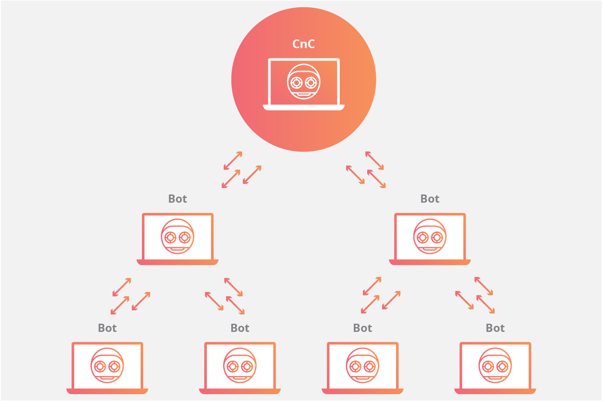
What is Botnet ?
Botnet is a group of internet connected devices that attacker get controlled of.

Slide 8
Impacts of Botnet
Can use to spread malware
Can shut down the whole network.
Attackers can steal legitimate and worthy data
Attackers can sell your network to a third party and operate large scale spam campaign.
Identity theft

Slide 9
Examples for Botnet
‘Star wars’ twitter botnet
this is a star wars themed twitter botnet that consist of 350,000 bot
accounts
Hajime malware botnet
Ironically, it is protecting these compromised IoT devices from being infected by additional malware
WireX Android Botnet
Google’s Play Store in particular has seen a surge of malicious apps and bots
disguising themselves as legitimate apps.

Slide 10
IoT

Slide 11
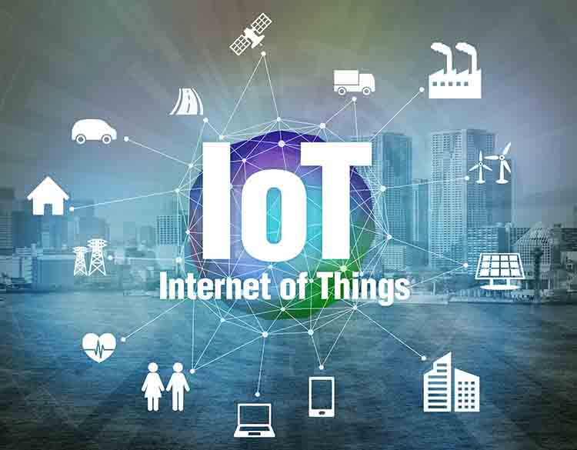
What is IoT
Simply the long form is Internet of Things.
This is system of interrelated computer devices ,which can be used to collect and exchange data.
Figure 1

Slide 12
Vulnerabilities of IoT
Data transferring and data storage is insecure due to firmware failure.
Insecure network services.
Absence of transport layer encryption.
Insufficient privacy protection due to user authentication problems.

Slide 13
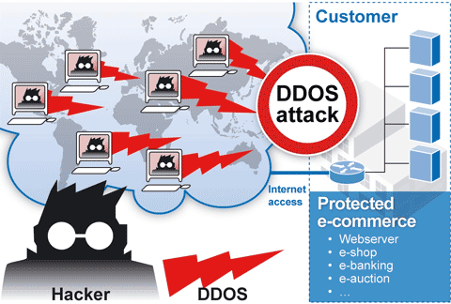
Threats of IoT
Suddenly IoT devices fails due to sloppy practices and poor usability.
Due to insecure network services cloud information could be leaked to bad hands.
Figure 2

Slide 14
Data Security and Cyber attacks
Most security breaches and hacking enter through backdoors.
But DDOS attacks come through a public communication channel which is used by regular users.
Therefore it is harder to differentiate a DDOS attack at the first place and general data protection mechanisms take some time to identify such incidents

Slide 15
Main issues identified
Identification of a DDOS attack using data protection strategy
Preventing a DDOS attack

Slide 16
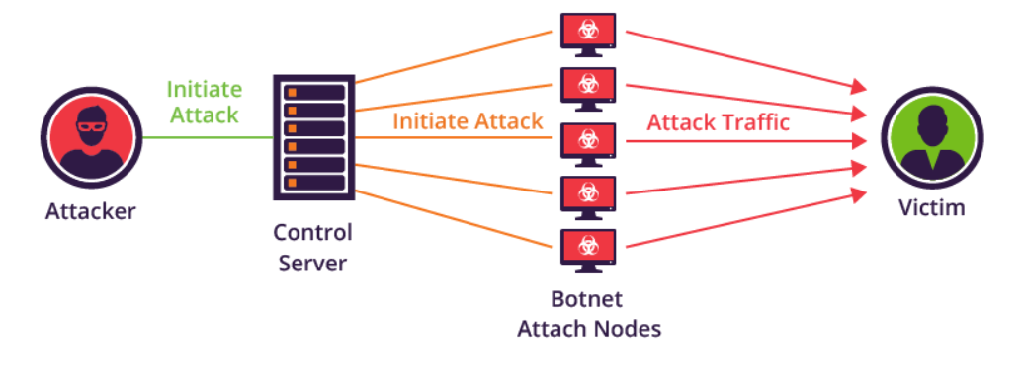
Identification of DDOS attack
Use systems that monitor traffic continuously for anomalous or potentially hostile activity
Using predictive analytics can also identify weak points in the network infrastructure such as open ports and interconnected systems.
Figure 3

Slide 17
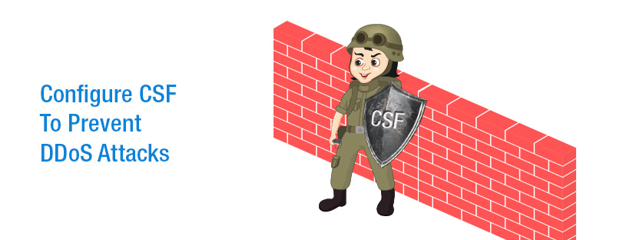
Preventing a DDOS attack
Firewalls and Intrusion Protection Systems (IPS)
Continuously review the logs and monitor the system performance.
Figure 4

Slide 18
Life lessons that could be taken
With real world examples

Slide 19

GitHub World-1.35Tbps
GitHub, which is a popular platform, was attacked with a sudden aggression of traffic on February 28, 2018.
The time, which was recorded, was 1.35 Terabits per second. This is the biggest DDOS attack according to the statistics.
GitHub logo

Slide 20
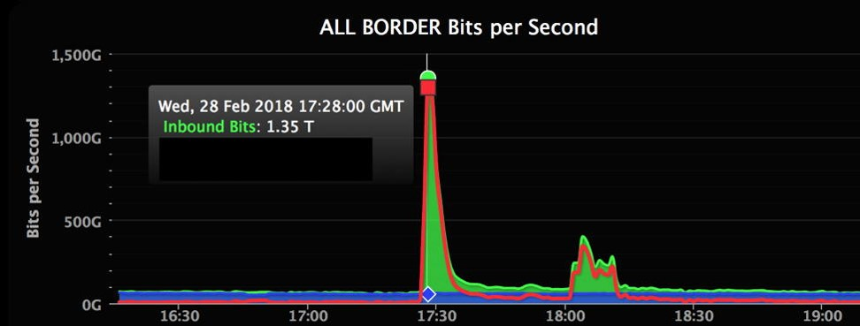
Below graph shows the difference between normal traffic level and this traffic level.
Figure 5
There were two projects which were hosted in GitHub, have been mainly focused.
The first project was showed the content of The New York Times for Chinese users.
Other project was run by greatfire.

Slide 21
GitHub said that at no point "was the confidentiality or integrity of your data at risk.“
GitHub.com was shortly unavailable from 17.21 to 17.30 UTC during the attack period.

Slide 22
References of images
Figure 1
Anon., TAPESTRYSOLUTIONS. [Online]
Available at: https://www.tapestrysolutions.com/2017/12/19/esi-and-the-iot-in-the-military-part-i-problems-from-the-past-and-how-the-internet-of-things-is-transforming-dod-supply-chain-management/various-smart-devices-and-mesh-network-internet-of-things-wire/
[Accessed 14 March 2019]
Figure 2
Soffar, H., 2018. OnineScience. [Online]
Available at: https://www.online-sciences.com/computer/ddos-attacks-risks-how-to-protect-your-website-from-ddos-attacks/
[Accessed 15 March 2019]
Figure 3
Shoemaker, A., 2017. Impreva INCAPSULA. [Online]
Available at: https://www.incapsula.com/blog/how-to-identify-a-mirai-style-ddos-attack.html
[Accessed 17 March 2019]

Slide 23
Figure 4
Navesh, M.N., 2016. SuppportSages. [online]
Available at: https://www.supportsages.com/configure-csf-prevent-ddos-attacks/
[Accessed 15 March 2019]
Figure 5
Kottler, s., 2018. The GitHub Blog [Online]
Available at: https://github.blog/2018-03-01-ddos-incident-report/
[Accessed 15 March 2019]

Slide 24
Conclusion
How did we cooperate
We have a WhatsApp group to communicate ideas for presentation with each other when we apart.
When we have no lectures or tutorials we went to terrace or a quiet place that we can discuss about problems and new ideas.
Vihanga helps us to find new websites that related to our each topics.
Kisal and I help to design each member’s slides for presentation.
Malshama and Hiruni helps us to find books for related topics and help to prepare speech for each other.
And also we share our knowledge.

Slide 25
Work Breakdown Structure
25
Distributer denial of service/BotNet attacks: how can they be avoided? How can they help us learn lessons for better data protection? Does the Internet of Things pose new threats to our private data?
Distributer denial of service/BotNet attacks: how can they be avoided? How can they help us learn lessons for better data protection? Does the Internet of Things pose new threats to our private data?
What is ddos. Impacts of ddos attcks. Examples for ddos attacks
Vihanga Sithum
What is botnet. Impacts of botnet attacks. Examples for botnet attacks
Dinu Senal
What is IOT. Vulnerabilities of IOT. Threats of IOT
Kisal Wedage
Data security and cyber attacks.
Hiruni Samaranayake
Life lessons that can be taken to avoid attacks and for better data protection.
Malshama Perera

Slide 26
Any questions?

